Slide 1
TRIZ Part 2

Slide 2
Technical Contradiction
Parameter A improves
Parameter B deteriorates
Temperature vs. Waste of Energy
Amount of Substance vs. Reliability, etc.
Invention surmounts the contradiction, achieving both
A
B
A
B

Slide 3
Inventive Principle
1 Segmentation
Divide the object into independent parts that are easy to disassemble,
increase the degree of segmentation as much as possible
Example:
1 Segmented furniture, modular computer components, foldable rule
2 Garden hoses may be joined to form a longer length

Slide 4
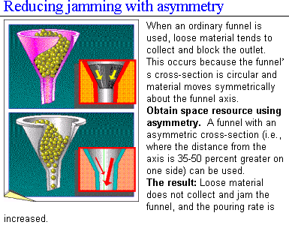
Inventive Principle

Slide 5
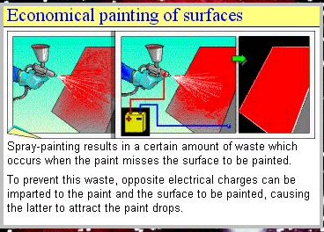
Inventive Principle
Using physical principles

Slide 6
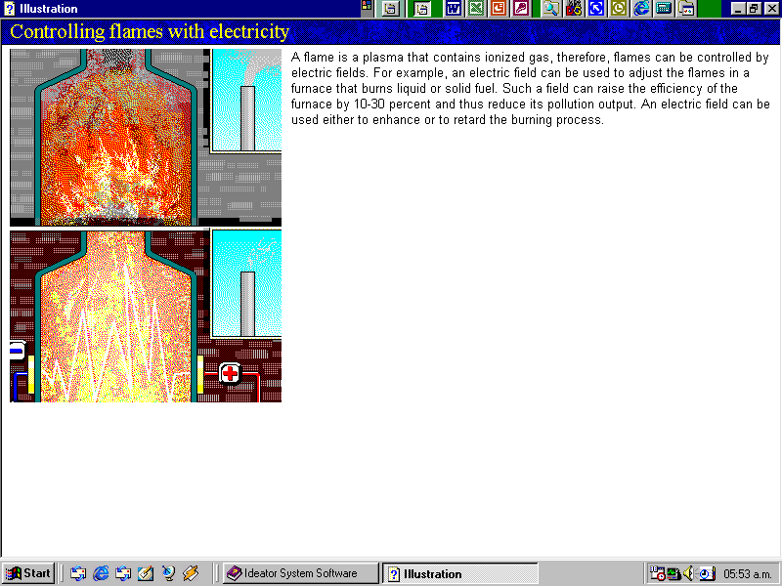
Inventive Principle
Using physical principles

Slide 7
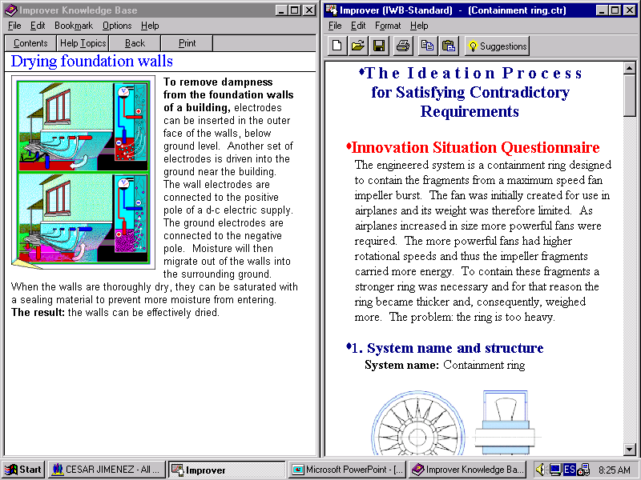
Inventive Principle
Using physical principles
Principle of opposite solution

Slide 8
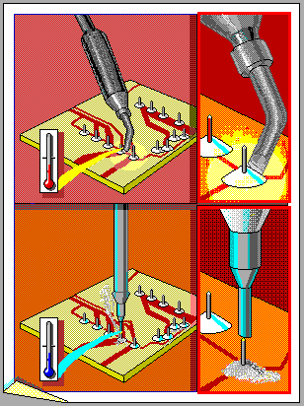
Inventive Principle Principle of opposite solution Unsoldering with liquid nitrogen
Components on prototype circuit boards may have to be repeatedly soldered and unsoldered. But integrated circuit devices and other components can be damaged by the heat used in unsoldering.
An alternative method for removing components is to touch each soldered joint with a probe cooled by liquid nitrogen. When cooled by this probe, the tin in the joint changes state, from white to gray tin – and increases in volume by 27 percent. The solder becomes a fine gray powder that can simply be shaken off.

Slide 9
Physical Contradictions

Slide 10
Physical Contradiction (PC)
A
Parameter A must be maximized
Parameter A must also be minimized
An innovative solution surmounts the contradiction, achieving both
A
A
A

Slide 11
Physical Contradictions
A characteristic must be high and low (opposed)
Example 1: An airplane wing must have a great area for a easy takeoff and small for high speed
Example 2: A pen end would have to be acute to draw fine lines, but flat to avoid to break the paper
A characteristic must be present and absent
Example 3: In order to clean with sand blasting the abrasive must be present (to make the abrasion) but it is not wanted that it remains in the product
Example 4: The undercarriage is necessary to land but unnecessary in the flight

Slide 12
Coating metallic parts
Metallic surfaces are chemically coated as follows: the metallic part is immersed in a bath consisting of a metal salt solution (e.g. nickel, cobalt, etc.).
During the reduction reaction, metal from the solution precipitates onto the part surface.
The higher the temperature, the faster the process; however, the solution decomposes at high temperatures, and up to 75% of the chemicals are wasted, settling on the bottom and walls of the bath.
Adding stabilizers is not effective, and conducting the process at a low temperature sharply decreases production.

Slide 13
Coating metallic parts
When coating parts chemically, the increase of the temperature is necessary only in the proximities of these.
the same parts can be warmed up, instead of warming up the solution
In this case, the chemical solution is hot where it is near the part, but cold elsewhere.
Also, the part can be heated by applying an electric current to it during the coating process.

Slide 14
Separation Principles
TRIZ looks for eliminating the physical contradictions by separation of the contradictory requirements:
Separation in space
Separation in time
Separation between the parts and the whole
Separation according to some condition

Slide 15
Separation in space
A characteristic becomes large in a place and small in another place
A characteristic is present in a place and absent in another place
Example 1:
The submarines that have sound detector to measure depth but the noise of the submarine interferes.
Put the detector several thousands of feet of the submarine with a cable, to separate the detector of the noise of the submarine
Example 2: The bifocal lenses

Slide 16
Separation according to some condition
If something is contradictory it has to be it right under the same circumstances?
Lenses have to be clear to be able to see trough them, however when there is much sun I put others with dark crystals.
Soon the crystals have to be clear and dark.
They have to be the clear and dark lenses under the same circumstances?
NO, they only have to be dark when there is much light.
Solution
Photosensitive lenses

Slide 17
Separation in time
A characteristic becomes large at certain moment and small to another moment.
A characteristic appears at certain moment and is absent at another moment
Example 1 : The pillars of concrete must be pointed to bury them easily but they do not have to be pointed to support to a load
= > take control of the pillars’ ends , which, after being inserted, may be destroyed by means of an internal explosive
Example 2:
Considering the problem of abrasive sand accumulation to use dry ice particles as abrasive.
After the effect of abrasion, the particles simply disappear by subliming

Slide 18
Separation between the parts and the whole
If something is contradictory, can we cause that although the parts make a thing individually the total result is indeed the opposite?
yes
yes
yes
yes
yes
yes
yes
yes
yes
yes
yes
yes
yes
yes
yes
yes
yes
yes
yes
yes
yes
yes
yes
yes
yes
yes
yes
yes
yes
yes
yes
yes
yes
yes
yes
yes

Slide 19
Separation between the parts and the whole
A characteristic has a value at the system level and the opposed value at the component level
A characteristic exists at the system level but it does not exist at the component level (or vice versa)
Example 1: A bicycle chain is rigid at micro level to have resistance, and is flexible at the macro level
Example 2: Epoxy resin and hardener are liquid before they are mixed, when already mixed both solidify.

Slide 20
Separation between the parts and the whole Gripping work pieces with complex shapes
It can be difficult, using an ordinary vise, to grip work pieces with complex shapes.

Slide 21
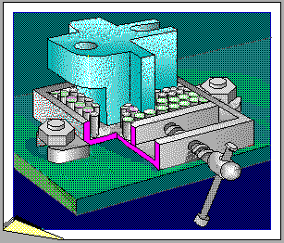
Separation between the parts and the whole Gripping work pieces with complex shapes
This problem can be solved with a vise whose jaws are each composed of a number of hard bushings.
Each bushing is free to move horizontally to conform to the shape of the work piece.

Slide 22
Separation according to some condition
A characteristic is high within a condition and low within another condition.
A characteristic is present within a condition and absent in another condition.
Example 1: A kitchen strainer is porous with the water and solid with the food.
Example 2: The water is “soft” when entering at it at low speed. However, if somebody jumps of a height of 10 meters, water feels as considerably hard.
This way, the speed of the interaction of the bodies with the water is the condition to be considered when asking for hardness

Slide 23
Turning Technical Contradictions to Physical Contradictions
Technical Contradiction:
Heating increases the productivity (A),
but wastes material (B)
Parameter of control C - temperature
Physical Contradiction: The temperature (C) would have to be high to increase the productivity and low to avoid waste

Slide 24
Turning Technical Contradictions to Physical Contradictions
Technical Contradiction
A
B
Control Parameter, C
C should be large, and
C should be small
}
Physical
contradiction

Slide 25
Technical contradictions
Exercise:
Identify the conflicting parameters in your present problem
Match the conflicting parameters with the parameters of the Altshuller matrix
Select the solution principles that are derived from the identified conflicts
Try to apply the solution principles selected to the specific problem

Slide 26
Physical contradictions
Exercise
In case of not being able to turn to solutions the selected inventive principles
Identify possible physical contradictions
Analyze the possibilities of applying some of the principles of separation to the specific problem
Finally, consider applying some of the 40 inventive principles to the specific problem

Slide 27
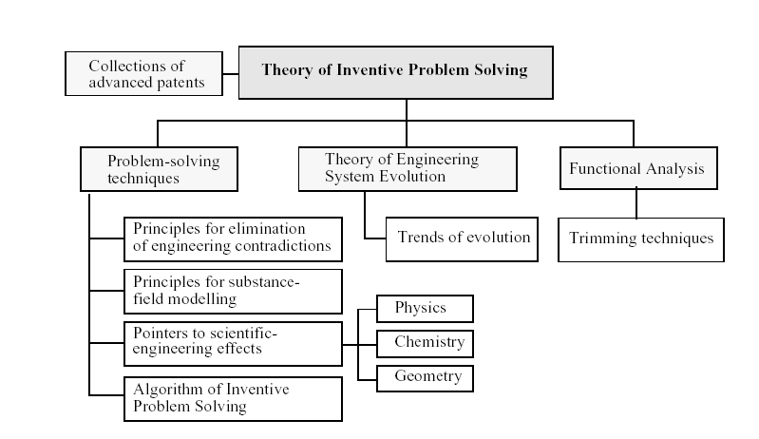

Slide 28
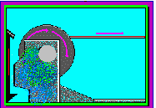
EXAMPLE: BRAKING OF AN AUTOMATIC WELDER DRUM
Automatic welding machines use a steel wire unreeled from a rotating drum as an electrode. The wire is pulled by a special motor located in the welding head. When welding is interrupted the motor stops, but the drum continues to rotate under its own momentum and entangles the wire.

Slide 29
EXAMPLE: BRAKING OF AN AUTOMATIC WELDER DRUM
To avoid this, the machine may be provided with a drum braking feature that necessitates a more powerful pulling motor and, hence, a heavier welding head. Braking can be computer-controlled, but doing so is expensive.

Slide 30
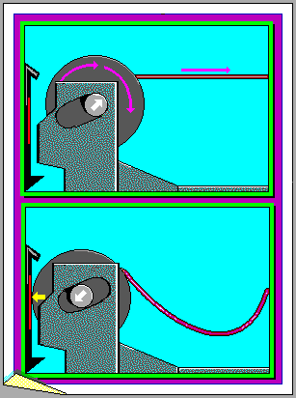
EXAMPLE: BRAKING OF AN AUTOMATIC WELDER DRUM
The solution: The drum's rotary shaft can be fixed, with movement only allowed along a groove cut at an angle of 1 to 3 degrees with the horizontal plane.
When the drum is not subject to the pulling force of the wire, its shaft is in the lowermost position, and the drum's side surfaces are pressed to brake plates under its own weight.
When the wire is under tension, the drum shaft moves along the groove and away from the brake plates.

Slide 31
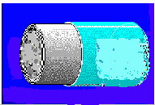
EXAMPLE: Extruding aluminum cans
Aluminum cans are extruded by forcing them onto a cylindrical steel die. The problem is that removing the cans from the cylinder is difficult.

Slide 32
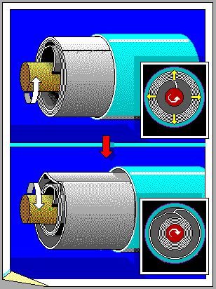
EXAMPLE: USING A COILED DIE
To solve this problem, the die can be made from a roll of sheet steel.
The outer edge of the sheet is welded to next layer of the roll so the outside of the roll forms the desired cylinder.
When the inner layers of the roll are uncoiled, they bear against the outer layer and stiffen it so it can be used to form the cans.
After extrusion is completed, the system coils the inner layers. The outer layer then becomes flexible, and the can is easily removed.

Slide 33
EXAMPLE: METHOD OF COLORING ACETATE THREADS
Acetate threads are made by twisting thin fibers produced by extruding a liquid solution through spinnerets.
The threads are colored by adding dye to the solution.
To change the dye, the system (including the pipes and spinnerets) must be cleaned, which is time-consuming and laborious.

Slide 34
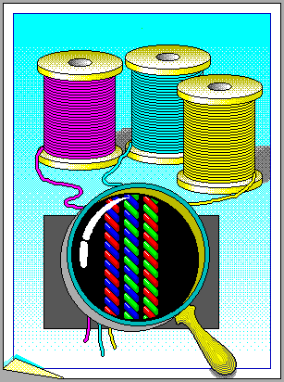
EXAMPLE: METHOD OF COLORING ACETATE THREADS
It is suggested that the thread be made of red, green, blue and transparent fibers. Any desired color can be obtained using combinations of these colored fibers.

Slide 35
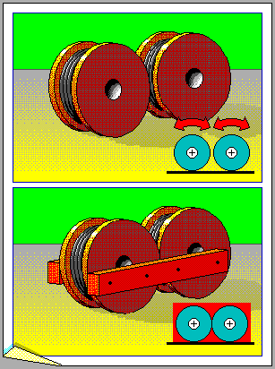
EXAMPLE: TRANSPORTATION OF BOBBINS
Due to loading requirements, large bobbins containing rope or wire must be transported in train cars, resting on their ribs.
In this position, however, the bobbins can roll due to bumps, and the walls of the bobbins can become damaged as a result.
To prevent rolling, special wooden supports must be made, installed, and removed.

Slide 36
EXAMPLE: TRANSPORTATION OF BOBBINS
An alternative method to prevent rolling is to simply join two adjacent bobbins with one or two struts.

Slide 37
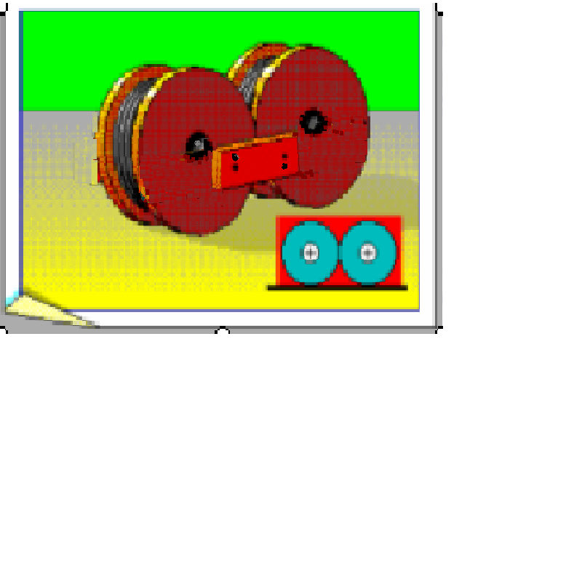
EXAMPLE: TRANSPORTATION OF BOBBINS
Short struts reduce costs

Slide 38
Inventive Problems Exercises
Applying inventive principles for problem solutions

Slide 39
1. Making holes in a hose
When trying to drill holes a hose it is deformed.
This leads to deformed holes
Look for a solution to this problem
Tip: Change the physical state

Slide 40
2. Oil is missing in a car tank
In a car tank with 3000 liter capacity 20-30 liter are being missed systematically during discharge
The situation has been analyzed thoroughly
Measurement instrument have been checked=> OK
Leakages were sought => NO
A theoretic thought suggested that the thin oil layer… => NO
Volumetric changes due to temperature? => NO
The driver became suspicious.
He was followed up to the delivery… => NO
How was oil going lost?
Tip: Doing it before

Slide 41
3. Cutting welded tubes (1)
In the production of welded tubes in a continuous rolling-welding machine, these are cut to a length of 12 feet, by means of a cut mechanism that travels with the tubes at a speed of 2 fps.
Whenever a tube is cut the mechanism returns 12 feet and begins a new cutting cycle.
This principle works correctly. But if it is desired to increase the productivity of the machine and that its speed is increased, for example to the double, the cutting speed is insufficient.

Slide 42
3. Cutting welded tubes (2)
The process time for cutting one tube consists of the cutting time tc and the return time tr and this is equal or smaller to 6 sec for the first case.
In the second case tc would have to be smaller than 3, but such speed is not possible to achieve.
Find a new solution for these case.
Note: The principle of “do it before”, as to have sheets previously cut would increase the costs of the process, because the machine would not work in a continuous way.
Tip: Do it a little less.

Slide 43
4. Putting a compressed spring within a device
It is required to put compressed springs within a device, but that this should be freed after introducing it.
Sometimes the process can be made helping the compression and assembly with other components.
However, in some cases compressing the springs with other components during the assembly is not feasible.
Find a way…
Tip: Changing the physical state of a substance.

Slide 44
5. Manufacturing glass filters
It is required to manufacture glass filters of 1m diameter and 2m height, with 1 cm holes (See figure)
To drill these holes is excessively expensive.
Find an economic method to obtain the filters with the given dimensions.
Tip 1: Tip: To do it the other way around.
Tip 2: Fragmentation and consolidation

Slide 45
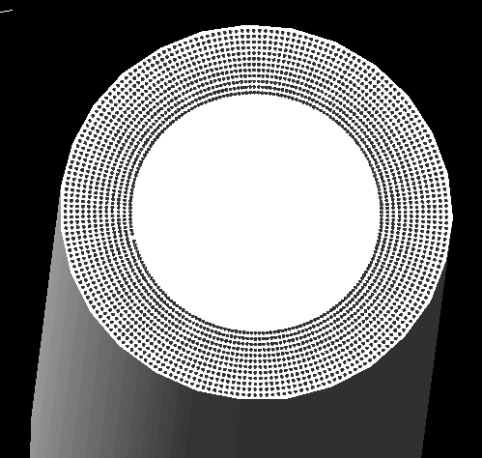

Slide 46
6. Testing material samples
In order to verify the resistance to acids, test samples are introduced in acid during certain time to analyze the effect of acid in their surface.
The container of acid for the tests is problematic and expensive.
Find an economic way to make the tests.
Tip: To do it the other way around.

Slide 47
6. Testing material samples (2)
Acid
Samples
Container

Slide 48
6. Testing material samples (3)
Ácido
Sample

Slide 49
6. Testing material samples (4)

Slide 50
7. Clearing iron shavings from a permanent magnet
On a permanent magnet of huge size (d = 1m, h = 2m), iron shavings fell accidentally (d=0.1 mm).
To clear these shavings becomes complicated. The polished surface of the magnet can be damaged if it is scraped.
Find a reliable and effective a method to clear the shavings.
Tip 1: To use auxiliary materials.
Tip 2: Field-Substance Diagrams.

Slide 51
8. Ice in electricity transmission lines
During the winter in cold countries the risk arise of ice forming around electricity transmission lines.
The weight of the ice may cause breakage of these lines.
If a line is used whose resistance produces heat, the losses of energy are too great. In addition, during the summer the heating can be excessive.
To put ferrite rings each certain distance, causes heat by magnetic induction, but this also it happens during the summer.
Find a physical principle that allows to avoid the heating in summer.
Tip: Magnetic properties.

Slide 52
9. High precision valve
A high precision valve is required for metering the components in an industrial process.
The required precision exceeds the possibilities of screw valves.
Develop a principle of regulation (not based on screws) for the opening of a valve that allows to control differences of the order of thousandths of millimeter.
Tip: Physical principles.

Slide 53
The Ideal Final Result (IFR) and Ideality (I)

Slide 54
Ideal Final Result (IFR)
The IFR is the imagined ultimate outcome of the problem solving process.
An element of the system or an element in the environment surrounding the system will perform the desired function(s) by itself with no cost(s) or harmful effect(s).

Slide 55
Ideal Final Result (IFR)
The IFR has the following 4 characteristics:
1. Eliminates the deficiencies of the original system 2. Preserves the advantages of the original system 3. Does not make the system more complicated (uses free or available resources). 4. Does not introduce new disadvantages

Slide 56
Evolution Towards Ideality
Each system performs useful and harmful functions
TRIZ follows to maximize the ideality: Ideal Final Result (IFR)
All useful functions
=
IDEALITY
All harmful functions + $

Slide 57
Ideal Final Result
IFR provides solutions that are near to the ideality
IFR does not increase the complexity of the system
A system performs a function without existing
The function is performed without introducing new resources in the system: using existing resources, (physical, chemical, geometric etc.)

Slide 58
“Ideality” measures progress toward the IFR
Ideal
Final
Result
Start
IFR
No harmful effects
No Cost
Satisfies Customer
needs
Conventional Approach
Inventive
Approach

Slide 59
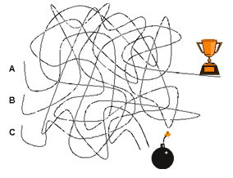
Evolution Focused to the Increase of the Ideality
IDEALITY
=

